Slide 1

M.Sc. in Data Science and Economics
SOCIAL NETWORK ANALYSIS ON POST TRADE DATA: CENTRALITY, SCALE FREE BEHAVIOR AND RESILIENCY OF THE NETWORKS OVER TIME
Supervisor: Prof. Giancarlo MANZI
External Co-Supervisor:
Dr. Enrico PAPALINI
Candidate:
Andrea IERARDI
960188

Slide 2

Objective
The aim of the study is the construction of Social Networks from post trade settlement instructions of Monte Titoli systems.
The study can be divided in two main networks constructions:
Monthly cumulative and non-cumulative Networks:
Centrality analysis
Scale-free networks pattern detection
Networks resiliency analysis
Daily Networks two case studies of disruptive events:
Impact of Covid19
Impact of BTP Italia and BTP Futura emissions

Slide 3





Technologies
PySpark
Extracting settlement instructions
Amazon Web Services (AWS) Data storing, processing and analysis
Python
Programming Language
S3 buckets Data storing
Sagemaker Notebooks
Data Analysis

Slide 4
Networks construction
Date range from May 2018 to end of July 2021
Companies' names have been anonymized except for Monte Titoli and CC&G
Data are aggregated based on:
Company deliverer – receiver couple
Financial instrument type: Corporate Bonds, Government Bonds, Funds, Shares, ETF and others.
Settlement Status: settled (S) or failed (N)
Graph representation:
Nodes: companies
Edges:
Directed: from deliverer to reicever
Weighted: with cash flow
Deliverer | Receiver | Sett Status | financial instr type | ETF indicator | Amount
Net Venture | Monte Titoli | S | Corp. Bonds | 0 | 10000
468 graphs

Slide 5
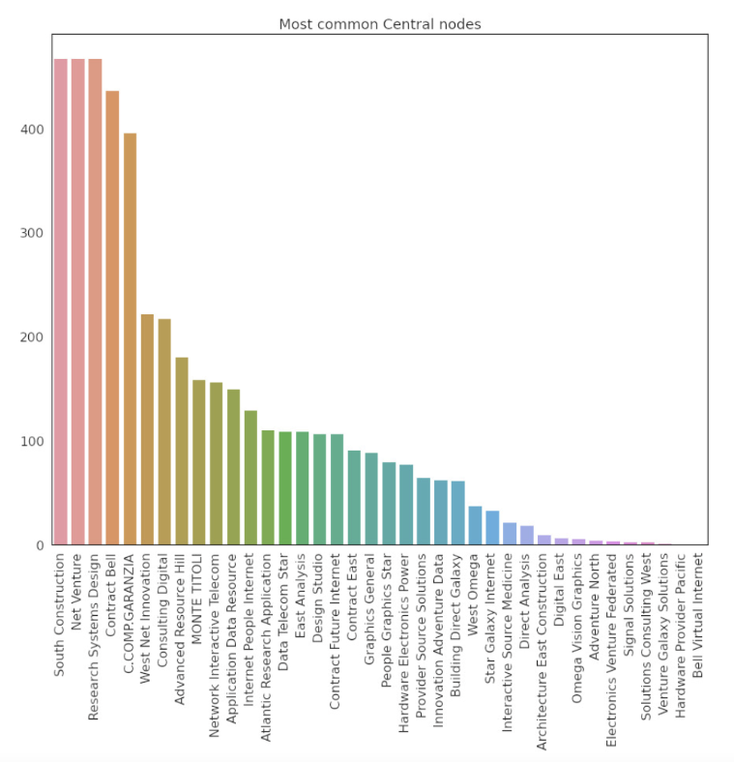
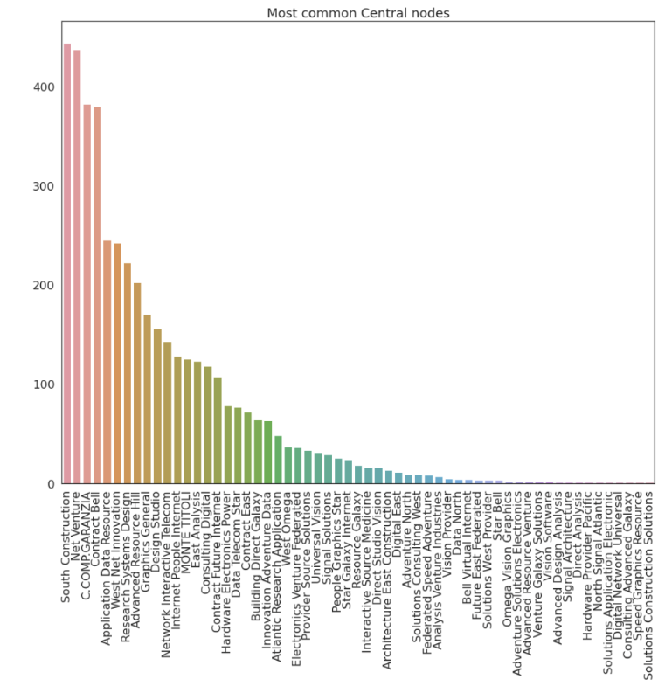
Central nodes - most frequent
Cumulative
Non-Cumulative
Cassa Compensazione e Garanzia (CC&G) protects contracting parties against default risk
CC&G has a high centrality because is deputed to clearing and netting

Slide 6
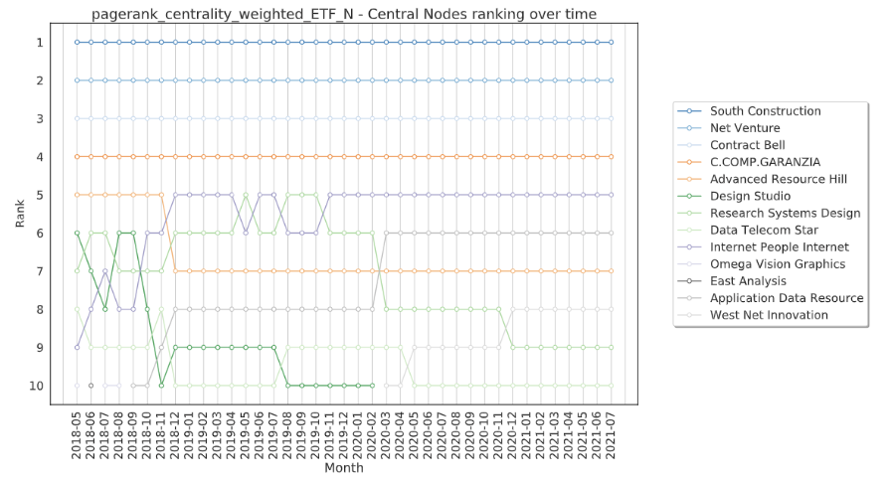
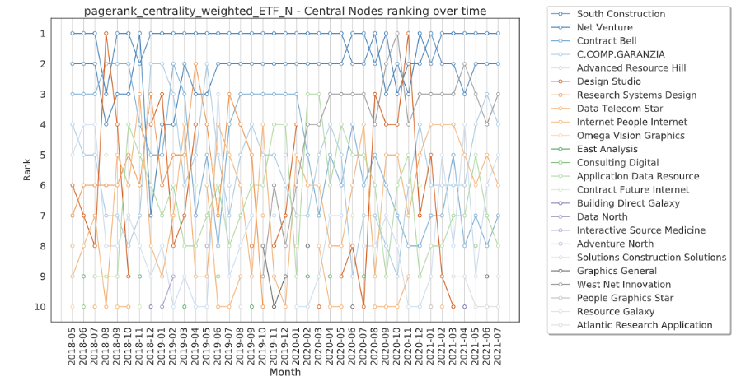
Central nodes - ranking
Cumulative
Non-Cumulative
Cumulative networks show a quite stable ranking over time
Non-cumulative networks exhibit a non-stable pattern of firms’ positions over time

Slide 7
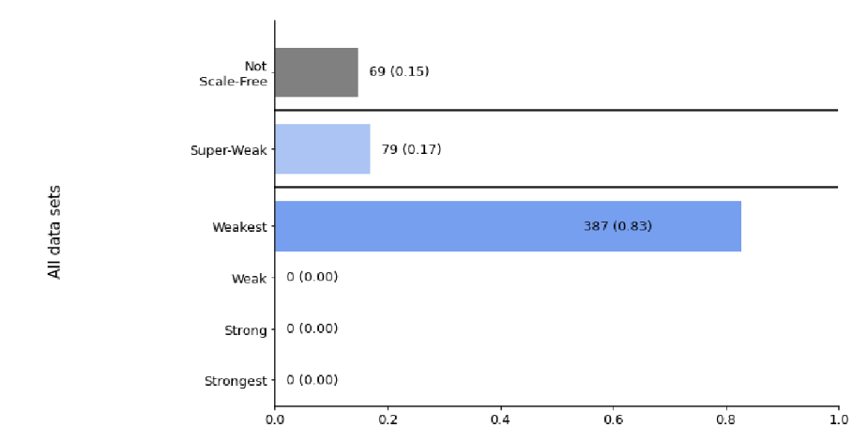
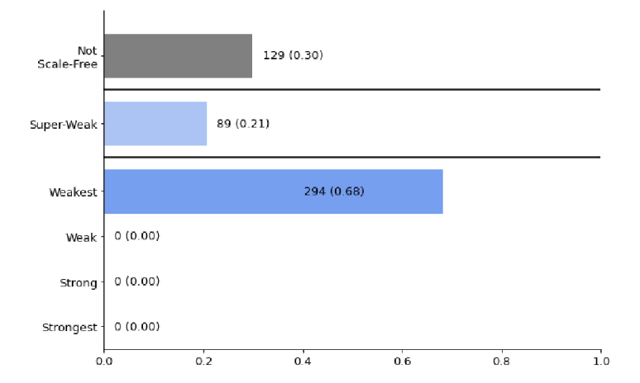
Scale free networks - degrees
Cumulative
Non-Cumulative
Scale free networks follow Power law distribution.
Cumulative networks are mostly scale-free.
Non-cumulative are more non-scale-free with respect to cumulative.

Slide 8
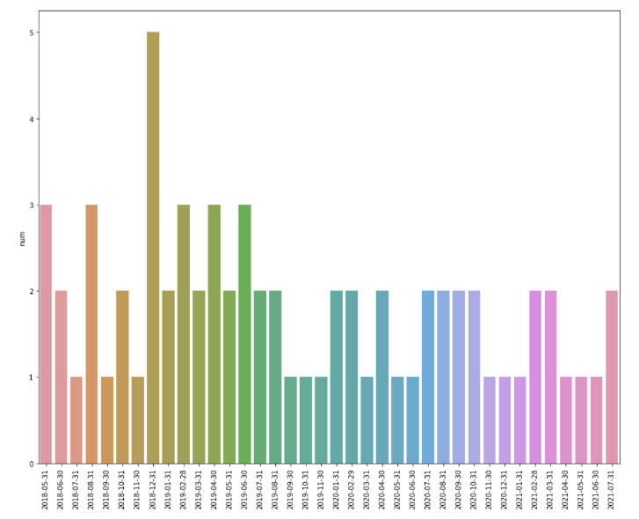
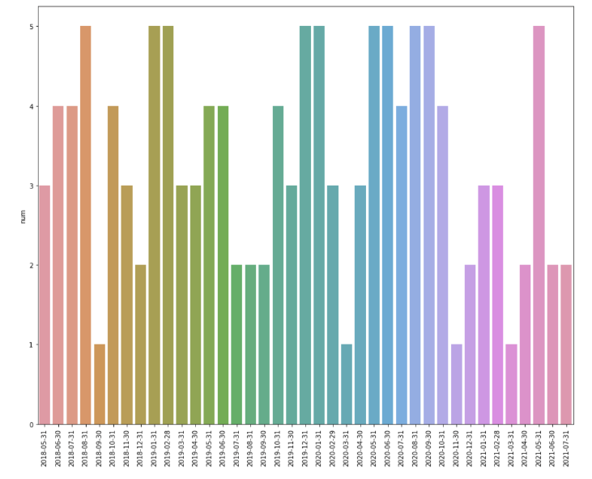
Non-Scale free - over time
Cumulative
Non-Cumulative
In cumulative networks as number the nodes and links increase, the number of non-scale-free networks decreases.
Non-cumulative networks does not show any pattern over time.

Slide 9
Node deletion
Different node deletion approaches are applied:
Random node deletion: a node is deleted randomly from the network
Localized node deletion: a deletion of a precisely selected node
We investigate if the structure of the network become divided into disconnected clusters after a node removal:
Networks presents only one main weakly connected component
If after node deletion, the network results with more than one weakly connected components, then the network is considered altered.

Slide 10
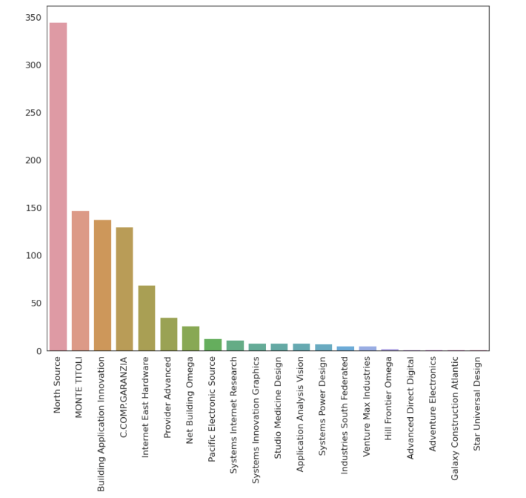
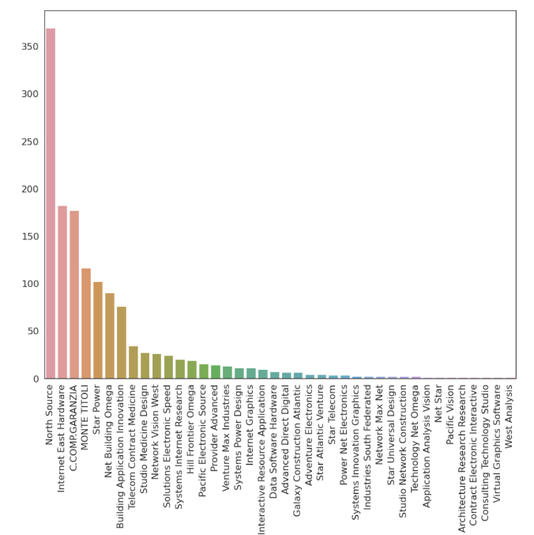
Node deletion - frequency
Cumulative
Non-Cumulative
Most frequent vulnerable nodes.
CC&G and Monte Titoli exhibit a high vulnerability because of their centrality and importance in the system.

Slide 11
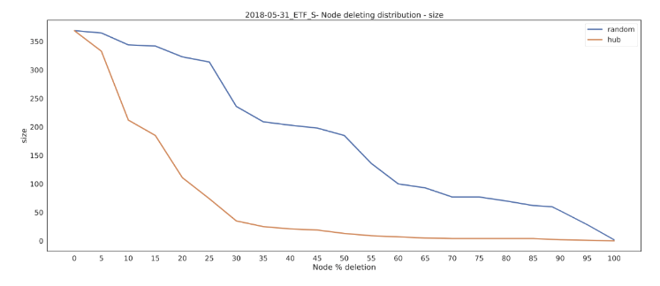
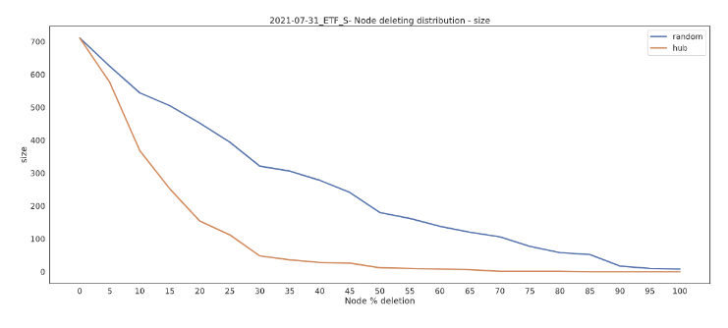
Node deletion - size
Cumulative May 2018
Cumulative July 2021
After deleting 30% of the hub nodes, the size decreases rapidly to less than 50 links.
Random node deletion results in a slower decrease in network size.
In July 2021, the curve is smoother.

Slide 12
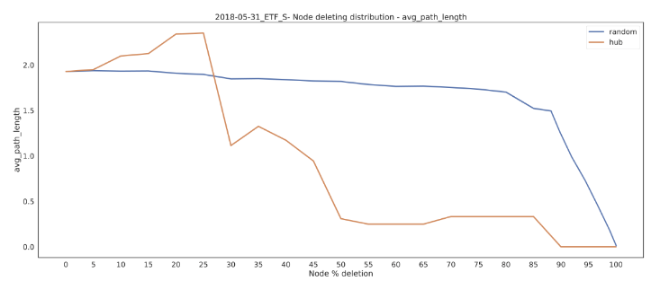
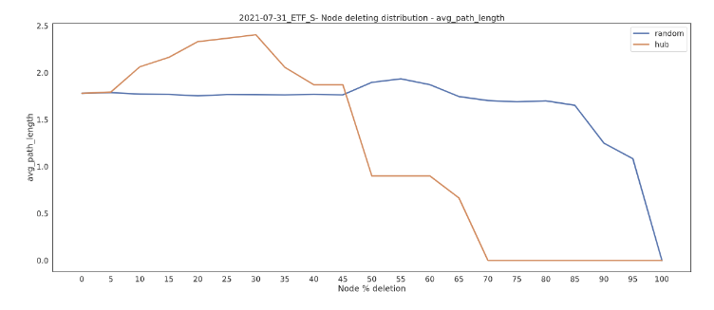
Node deletion - average shortest path
Cumulative May 2018
Cumulative July 2021
The elimination of hub nodes results in increased distance
After reaching 30% of hub node removal, the average shortest path length reduces significantly.
Random removal presents a stable shortest path length.

Slide 13


Daily analysis
Disruptive events could irreversibly change topology and structure of the networks, such as the September 11th, 2001, terrorist attack.
Two different case-studies of disruptive events:
The impact of Covid-19:
Changes in networks topology
Period from January 2019 to December 2021
The impact of large BTP emissions:
Changes in networks topology
Emission of BTP Italia and BTP Futura

Slide 14
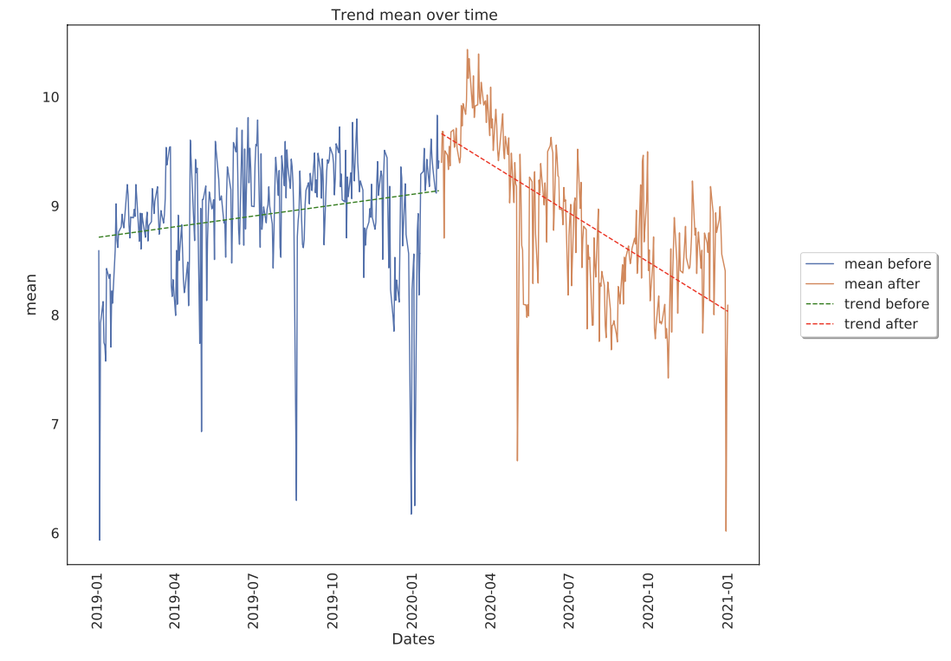
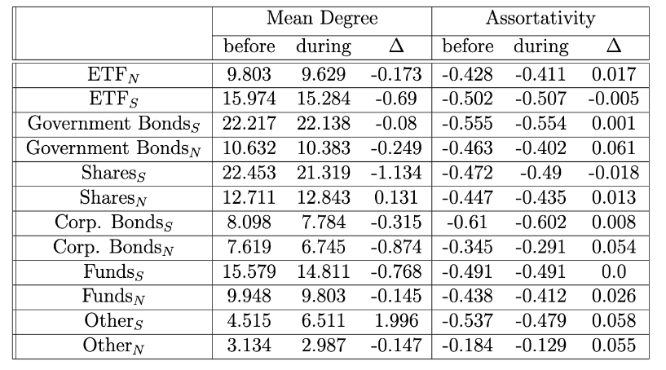
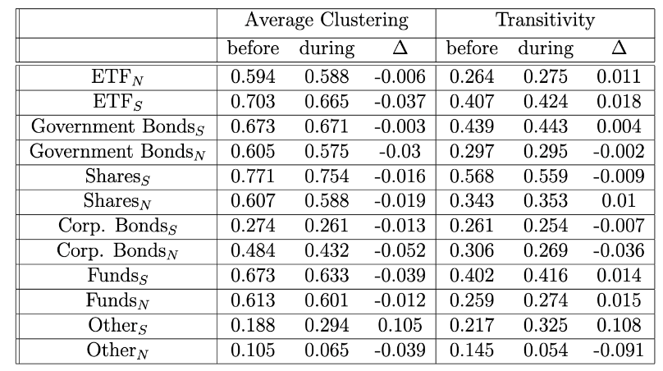
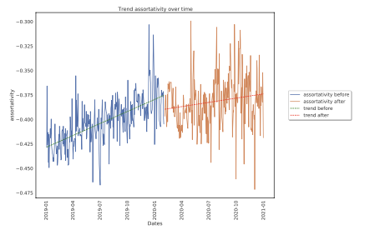
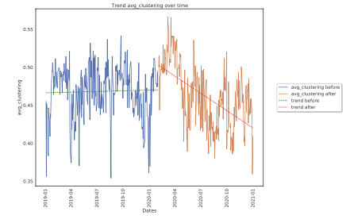
Impact of Covid19
The Coronavirus pandemic has impacted the networks:
Mean degree decreases
Assortativity increases
Average Clustering decreases

Slide 15
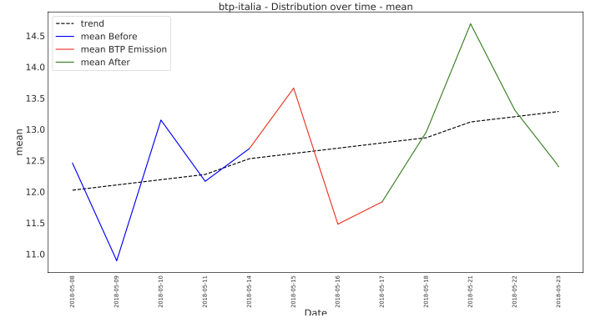
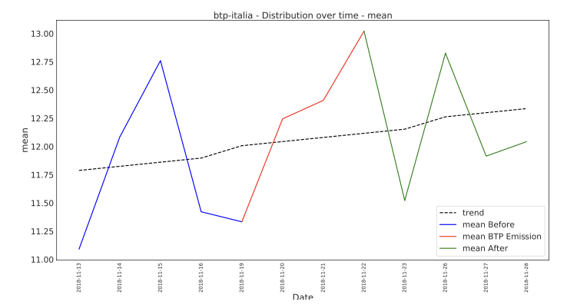
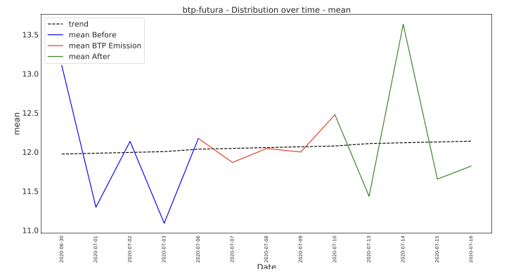
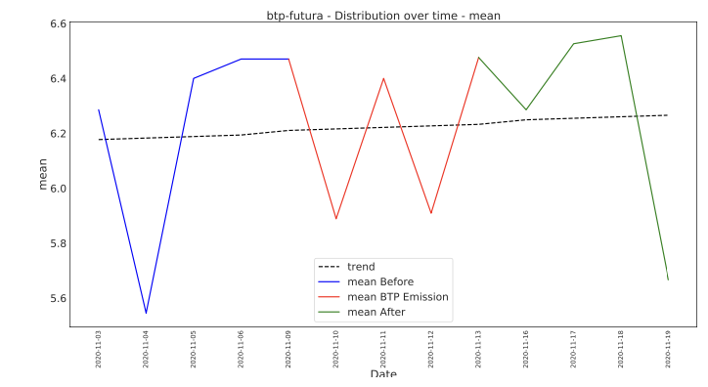
Impact of BTP emissions
BTP Italia
BTP Futura
Only Government Bonds networks are considered.
There is no evidence that the emission of BTP Italia and Futura impacts the topology of the networks.

Slide 16
Conclusions
Monthly Networks:
Centrality analysis: central nodes in cumulative networks show a stable pattern in ranking, non-cumulative does not exhibit any recognizable behaviors.
Scale-free networks: cumulative networks show a predominance of scale-free behavior with respect to non-cumulative.
Networks resiliency: eliminating an important node has a greater impact on the network topology than randomly eliminating.
Daily Networks:
Covid19 had a negative impact on networks topology: decreased mean degree, disassortativity, clustering coefficient.
BTP Italia and BTP Futura emissions had no impact on networks topology.

Slide 17
Future works
For future works, there are several possibilities:
Monthly networks analysis also on daily networks (centrality, scale-free, resiliency)
Similar studies apply to data from different contexts and environments.
Try other types of node elimination: almost-failures attack and efficient link attack
Impact analysis on settlement discipline (penalty on instructions with long time failed status) that went live on 1st February 2022.

Slide 18
Thank you

Slide 19
Monte Titoli, CC&G and Euronext
A Central securities depository (CSD) is a specialized monetary organization holding securities like shares, allowing an easy transfer of ownership through a book entry rather than by a transfer of physical certificates. This allows brokers and financial companies to hold their securities at one location where they can be available for clearing and settlement.
Monte Titoli is an Italian CSD, and it is authorized to operate securities settlement services.
Euronext Securities is composed by Euronext VPS (Norway), Interbolsa (Portugal), Monte Titoli (Italy), VP Securities (Denmark).
Cassa Compensazione and Garanzia (CC&G) plays a central role of central counterparty, which is an institution interposed in securities trades between the two contracting parties, protecting the latter against default risk. Now called Euronext Clearing.

Slide 20
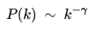
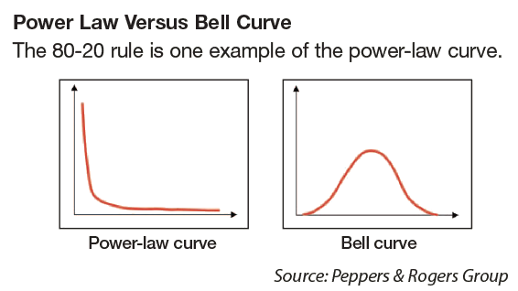
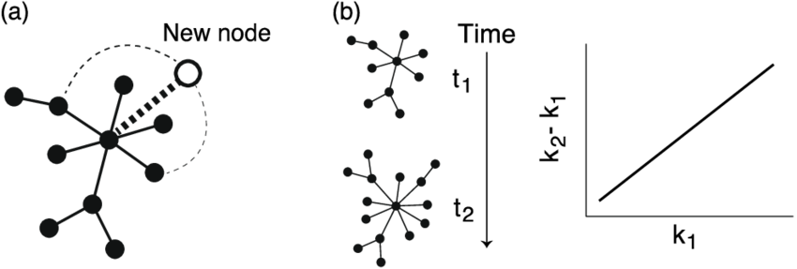
Scale free networks
Scale free networks follow Power law distribution
Properties:
Growth: over an extended period of time, new nodes join an already existing system
Preferential attachment: new nodes prefer to link to the more connected nodes.
Scale-free Resiliency: Scale-free networks are more resistant to random disconnection of nodes.

Slide 21
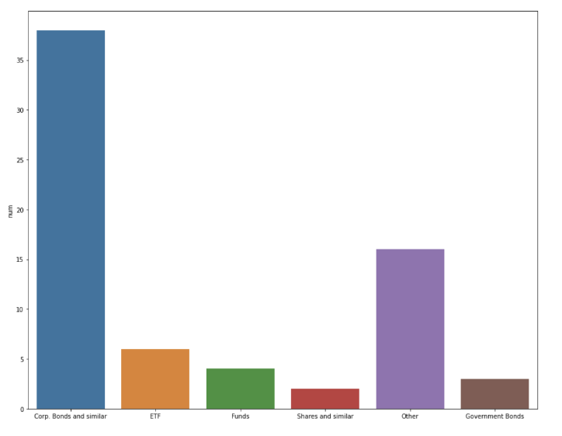
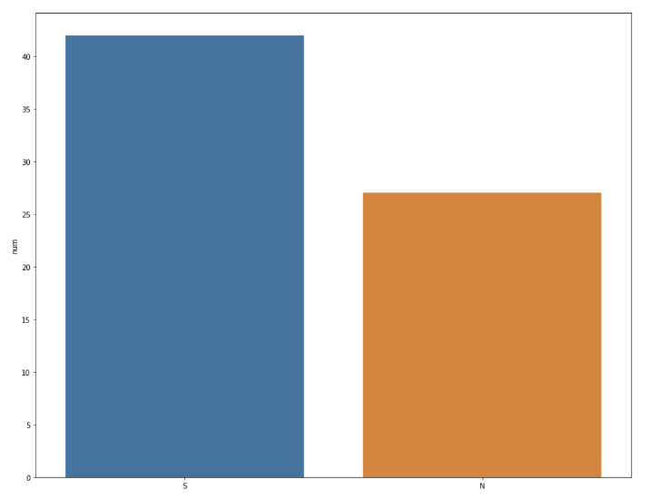
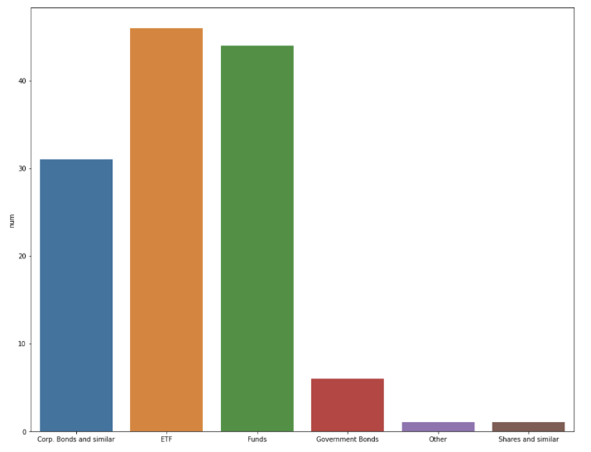
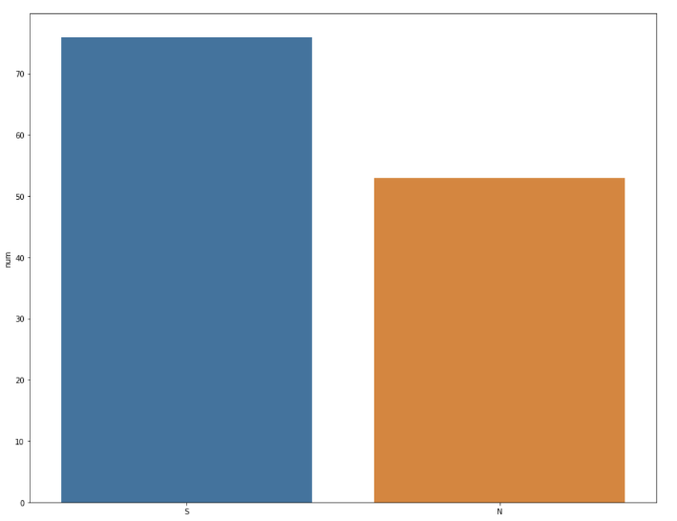
Non-Scale free - instr. type and sett. status
Cumulative
Non-Cumulative
Corp. Bonds
ETF
Funds
Shares
Other
Gov. Bonds
Settled
Failed
Corp. Bonds
ETF
Funds
Shares
Other
Gov. Bonds
Settled
Failed
Scale-free behavior is not present in cumulative networks mostly in corporate bonds and other
Scale-free behavior is not present in non-cumulative networks mostly in corporate bonds, ETF and funds
Similar behavior differentiating by settlement status for cumulative and non-cumulative

